Slide 1
Dementia Training
Officer Emily Tebo, South Hadley PD
teboe@southhadleypolice.org 413-538-8231
Karen Buscemi, PMH-Nurse Practitioner
geriatricnp@gmail.com www.geriatricnp.com 413-531-7640

Slide 2
Introduction
Statistics
Diagnosis
Alzheimer’s, Vascular, Lewy Body, FTL, etc….
Treatment (Cases from SHPD)
Delirium
Suicide
Abuse (Referrals)
Interaction with Law Enforcement/ Videos/Resource
  Dementia Awareness- Dignity/Respect/Decrease Isolation
  Traffic Stop- Driving Assessment
  Missing Person- Wandering (on foot)
  Report of Theft- House Call
  Report of Agitation/Combativeness- Medical Needs (delirium)
Notes:
How presentation will benefit audience: Adult learners are more interested in a subject if they know how or why it is important to them.
Presenter’s level of expertise in the subject: Briefly state your credentials in this area, or explain why participants should listen to you.

Slide 3
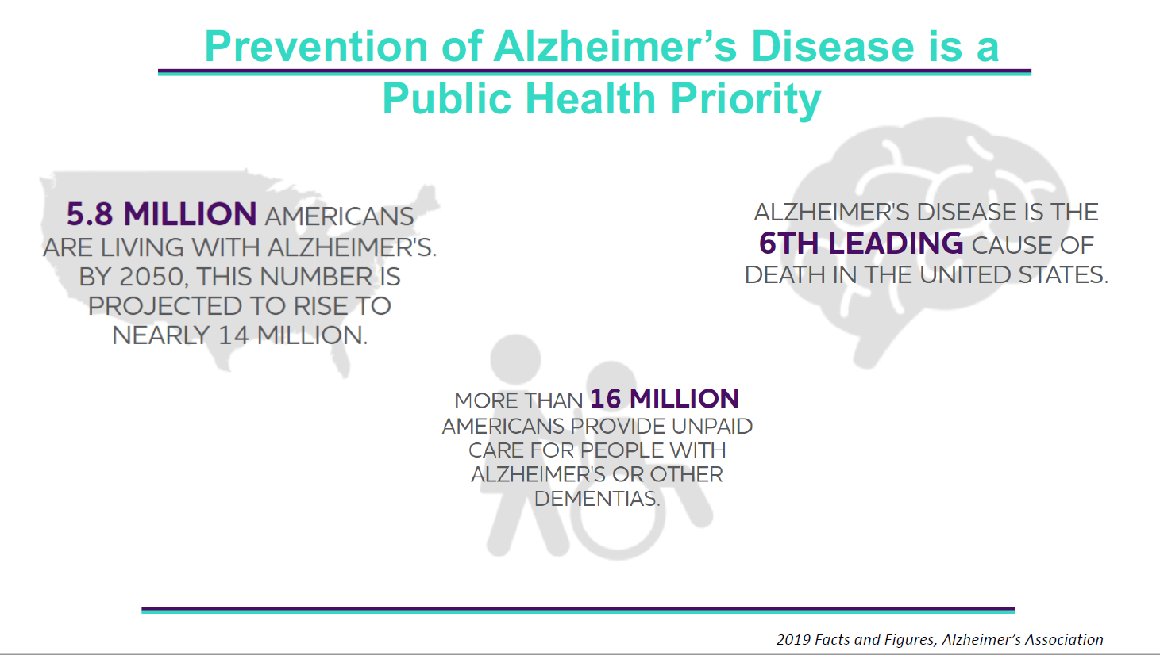

Slide 4
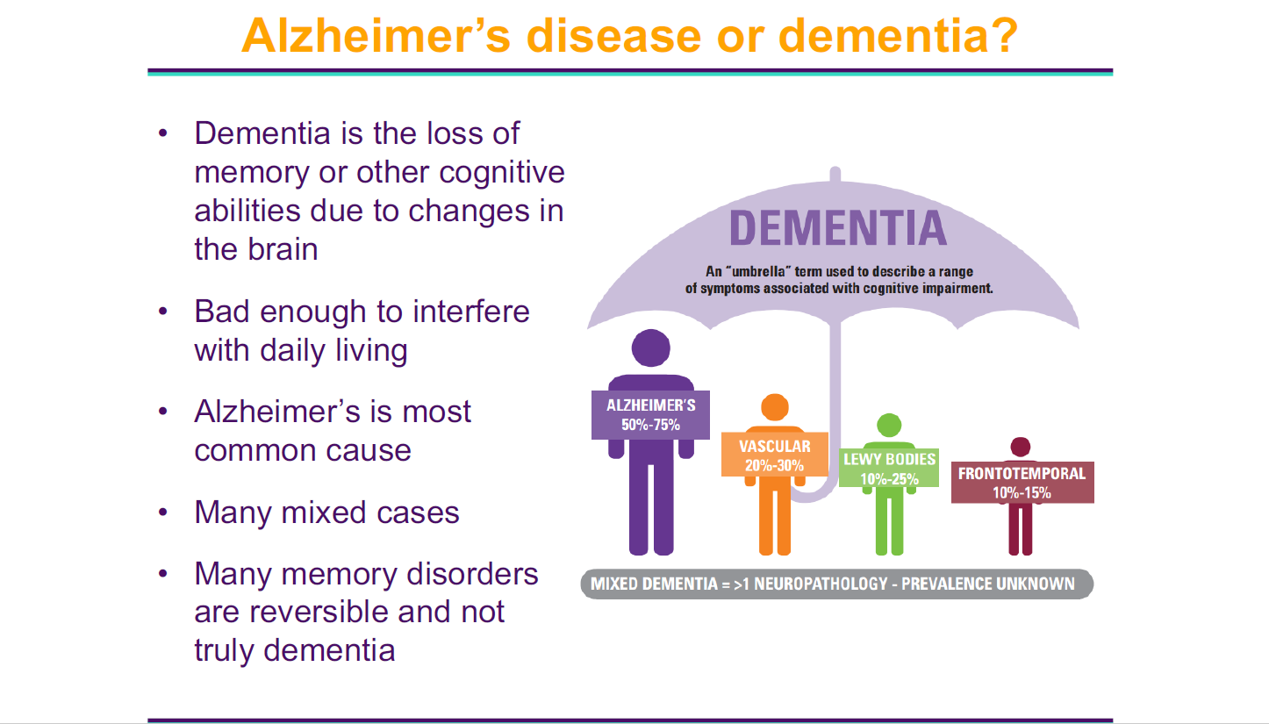

Slide 5
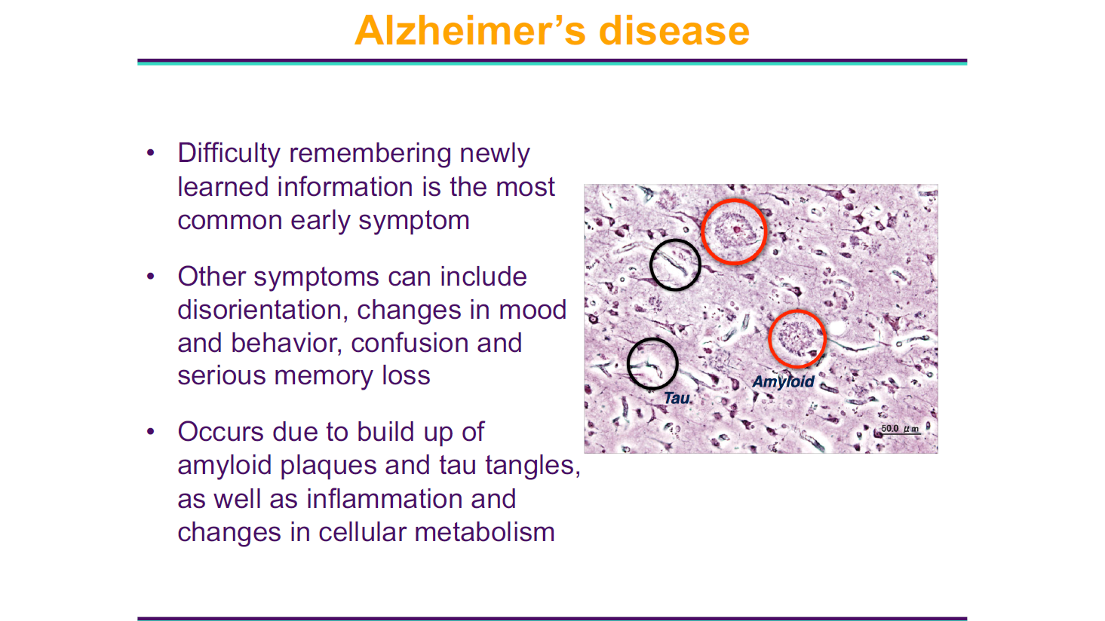

Slide 6
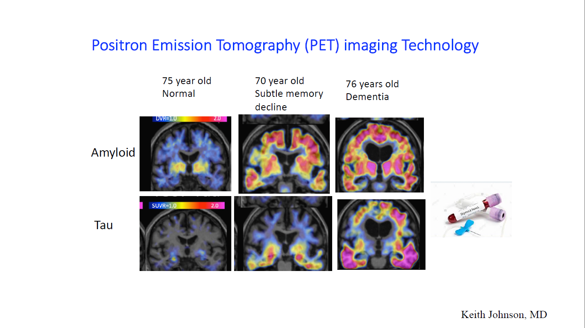

Slide 7
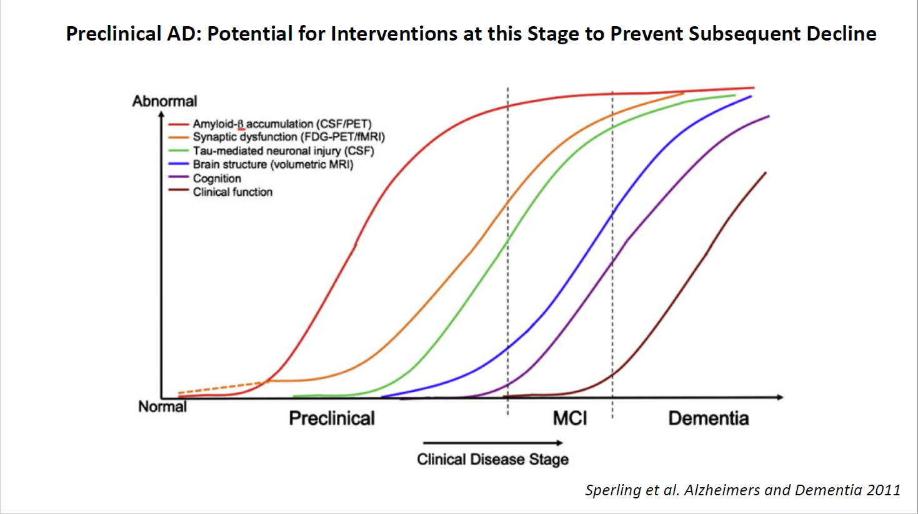

Slide 8
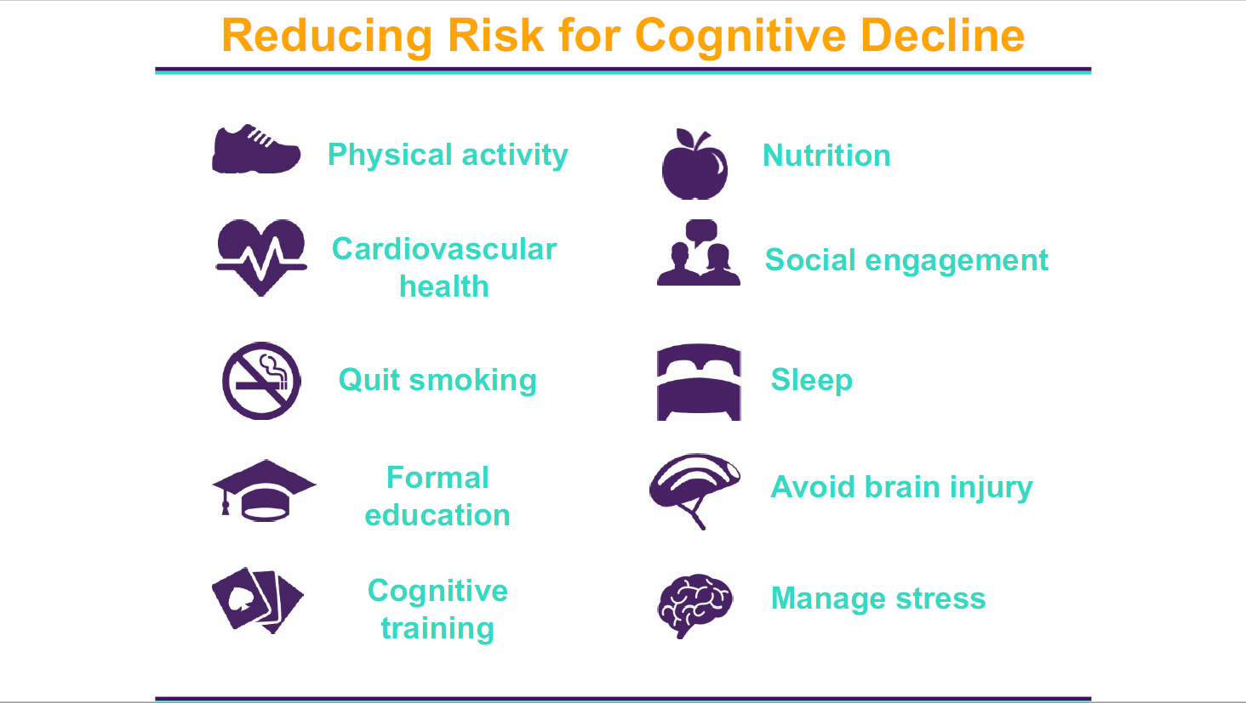

Slide 9
Dementia FACTS
All Dementias are progressive and terminal illnesses
Aging is the primary risk factor
Protective Factors include: diet, exercise, educational level (cognitive reserve), limit ETOH, 8-10 hrs sleep, socialization
Warning Signs: Memory loss, Difficulty performing tasks, Problems with language, Disorientation to place/time, Poor judgment, Misplacing things, Changes in mood, personality and behavior, Loss of initiative, Problems with abstract thinking

Slide 10
Alzheimer’s Dementia
One in Ten > 65 years of age 5 in 10 > 85 years of age
Diagnosis of solely Alzheimer’s disease will live an average of 8-15 years from the onset of symptoms
Skilled Primary Care Physicians > 90% accuracy of Diagnosis
Specialists- Psychiatrist, Neurologist, Neuropsychologist, Nurse Practitioners, Social Workers, etc…..
NO SINGLE TEST- Medical History, Physical Exam, Labs, Head Scan (CAT, MRI, fMRI, PET…)
Timely identification/diagnosis enables patient to take an active role in treatment decisions and future planning.
Dementia – Take control, a chronic disability

Slide 11
After Diagnosis- The “WHAT NOW?”
Typical Priorities-
  Early Stage = Life Prolongation
  Middle Stage = Function
  Advanced Stage = Comfort, Comfort, Comfort!!
Learning Behavioral Management Techniques
  Enter their reality, do not try to force them into yours
  Respond to the emotion behind the statement
  Change YOUR behavior and/or the environment
  Do NOT attempt to reason with. Do not say “NO”
  Use REDIRECTION, DISTRACTION, REFOCUSING, etc….
  Use “FAILURE FREE” Activities, focus on their strengths

Slide 12
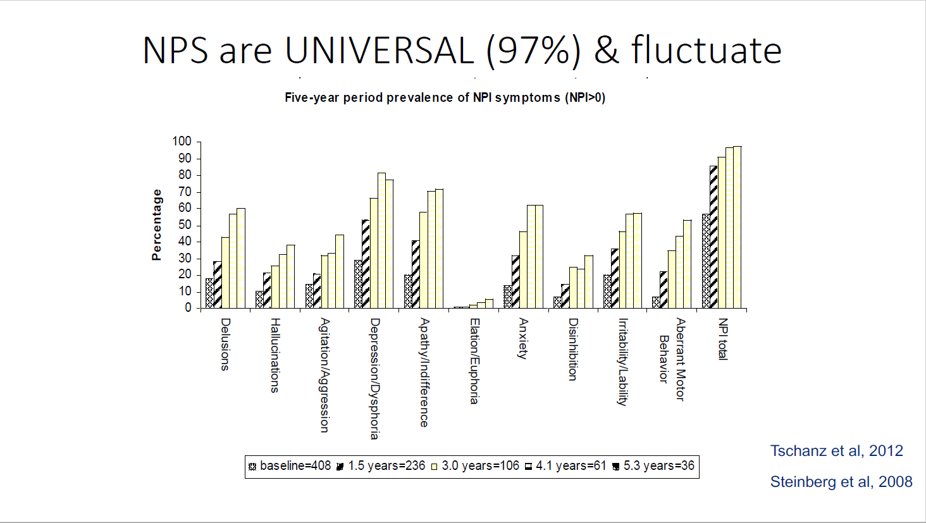

Slide 13
DEMENTIA BEHAVIORS
BEHAVIOR = IN THIS ORDER!!
1. UNMET NEED
2. ENVIRONMENTAL IRRITANTS
3. MEDICAL ILLNESS
4. PSYCHIATRIC TREATMENT
Caregiver Stress
Denial Exhaustion Neglect/Abuse
Anger Sleeplessness Homicide/Suicide
Guilt Irritability
Anxiety Health Problems

Slide 14
***Delirium***
Acute confusional state
Rapid onset – hours to days
Symptoms may fluctuate sharply
Impaired orientation, memory, perception
May be agitated, restless, wandering, poor attention
CAUSES: Infection, Medication, Illness(cardiac/resp), ETOH, Dehydration, etc
IMMEDIATE MEDICAL ATTENTION REQUIRED – “TOXIC BRAIN”
Section 12a…..when, how, etc…..
Prognosis- Return to premorbid function IF cause is corrected in time

Slide 15
DEMENTIA MEDICATIONS
MEMORY MEDICATIONS 1997 (can be toxic, not that effective….what do we have?)
1. Aricept, Razadyne, Exelon, Namenda
Monoclonal Antibodies 2021 (Controversy- Biogen/FDA/Clinical difference?/ARIA-brain bleed/$$)
1a. Aduhelm, Leqembi (Intravenous, 1hr, every 2wks)
Antidepressants (some safer that others, used for anxiety, depression, sleep, appetite, agitation, etc.)
2. Prozac, Paxil, Zoloft, Celexa, Lexapro, Effexor, Trazodone, Remeron, Cymbalta, Wellbutrin, etc
Mood Stabilizers (mood, agitation, aggression, etc.)
3. Depakote, Neurontin, Tegretol, Lamictal, etc.
Antipsychotics (many side effects, but at times extremely useful. Use with caution, reassess!
(delusions, hallucinations, agitation, aggression, mood, etc.)
4. Seroquel, Risperdal, Zyprexa, Abilify, Haldol, etc.

Slide 16
SUPPORT NETWORK- “TELL OTHERS!!!”
PLAN AHEAD- Healthcare Proxy, Power of Attorney, Living Will, Move to CRC, ALF?
SAFETY- Register with local PD (Person at Risk), MedicAlert (Project Lifesaver, Jiobit, Alarms), Driving
SUPPORT GROUPS/MEMORY CAFES- Caregiver support, café for patients/activities
ALZHEIMER’S ASSOCIATION- information, care consultations, research, educational programs, public policy. LOCAL CHAPTER- Springfield 413-787-1113 / 1-800-272-3900 24/7
LEGAL/FINANCIAL- Elder Law Attorneys, District Attorney’s Office Elder and People w Disabilities unit. Check with local court house.
RESPITE SERVICES- Informal- church groups Formal- Visiting Nurse
Council on Aging- WMEC, Ann Andras-social services

Slide 17
Geriatric Suicide
May be underreported by 40% or more, (silent suicide deaths for medical noncompliance, overdoses, self starvation, dehydration and accidents
Only 2-4% have been diagnosed with a terminal illness at time of death
White males > 85 are at greatest risk compared to ALL age/gender/race
1 Elder suicide every 1-1.5 hrs in US
Of all elder suicides, 81% men
40-50% have NEVER received mental health services

Slide 18
Elder Abuse Facts
Physical, Emotional, Sexual, Financial, Neglect, Abandonment, Confinement
Perpetrators- Spouses, Children, Assisted Living Staff, Home Care Staff, Etc.
Occurs 1 in 10 > 60 yo, Only 1 in 14 cases reported, Almost 60% family member
Social Isolation & Cognitive Impairment(Dementia) = Vulnerable to abuse
Elders who have been mistreated have a 300% higher risk of death
19A Reporting
Educate elders: decrease isolation,join groups, open own mail, secure documents- POA/HCP, direct deposit, Western Mass Elder Care, Reporting

Slide 19
Situations involving law enforcement
Exhibiting erratic driving/breaking general rules of the road
Crossing a roadway/walking through traffic unaware of danger
Wandering with a dazed/lost appearance, or appears fearful, agitated, crying
Sitting in a car along the side of the road (out of gas, etc)
Inappropriately dressed for the situation/weather (barefoot/no coat-winter)
Call to police regarding missing items, break-in, or “neighbor spying”
Difficulty acting appropriately with others
A domestic violence or abuse call that turns out to be a caregiver w an individual with Dementia
A shop-lifting accusation “stealing” from a local business when they actually believe they paid for the item, or that it had always been theirs
Inability to follow/understand simple requests, “May I see your ID/License”

Slide 20
REFERRALS
PERSON/ELDER AT RISK
ELDER ABUSE –MANDATORY REPORTING FORM
REQUEST FOR IMMEDIATE THREAT/LICENSE SUSPENSION

Slide 21
Videos
Police Scotland – Dementia Awareness
https://youtu.be/KZdnLcgY-3k
Dennis MA PD- Driver Assessment/Traffic Stop
https://youtu.be/hI7mZDO8uic
Montgomery County PD -Missing Person (on foot)
https://youtu.be/Ynssd2GcHfg
Orange County PD – House Call /Report of Theft
https://youtu.be/5ype1MUb1Ew
Alzheimer’s Greater Los Angeles
https://youtu.be/qc0QoGLVfI0

